Slide 1
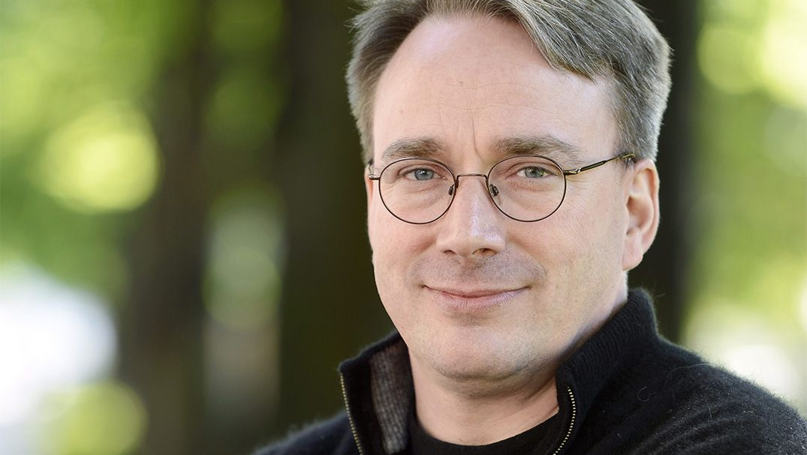
Linus Torvalds
Ali Çavdar 10-E 1444

Slide 2
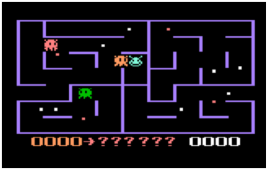
Early Life
Linus Benedict Torvalds was born in Heliski, Finland in 1969.
His interest in computers began at the age of 11 and he started experimenting with them.
He attended University of Helinski and graduated with a masters degree in computer science.
Also at the time he wrote his own Pac-Man clone, called Cool-Man.
Cool-Man

Slide 3
Have you ever...
Used an Android phone?
Interacted with your Wi-Fi router?
Used the modern internet?

Slide 4
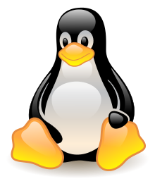
What is the Linux Operating System?
If your answer is yes to at least one of these questions (Of course) then you've used something Linus has created: The Linux operating system. It was originally created as a hobby of Linus back in 1991.
Linux operating system is fully modular, free to use and open source. That's why it is secretly the most popular operating system in the world.
99% of the web's servers run linux underneath them as of today. Android phones also run linux underneath.

Slide 5
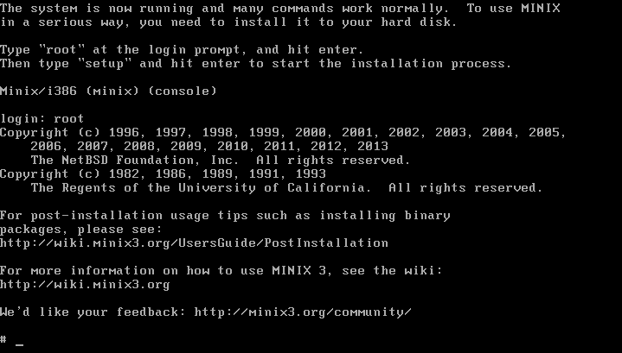
Early days of Linux
On January 5th 1991, he recieved his Unix clone called Minix, which he used to base Linux on and started working on Linux itself.
In the time he said, "Just as a hobby, won't be anything professional" which aged like milk.
His academic career was interrupted after his first year of study when he joined the Finnish Navy Nyland Brigade in the summer of 1989, selecting the 11-month officer training program to fulfill the mandatory military service of Finland.
Minix

Slide 6
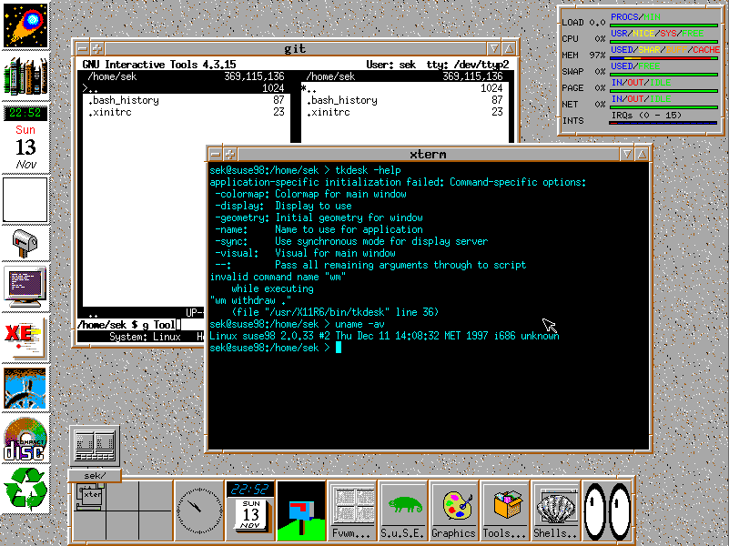
Early days of Linux
- The idea behind Linux was to make a free and open source operating system that can be used by anyone to modify the software for their needs. This is what made Linux better than other Unix clones.
Torvalds released the first Linux prototypes in late 1991. He released Linux 1.0 in 1994.
An old version of a Linux distro called openSuse. This version was released in 1998.

Slide 7
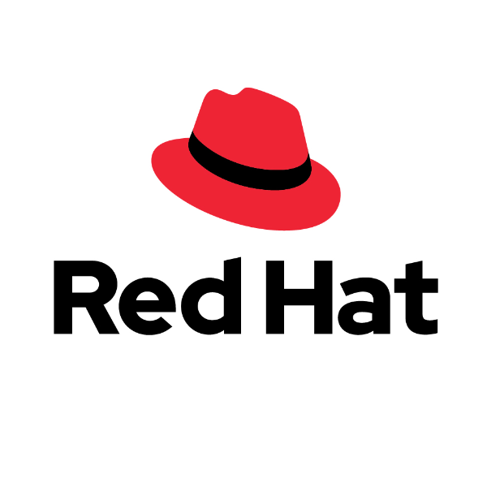
His career
In 1996, Torvalds accepted a position at a company known as Transmeta in California, where he worked from February 1997 to June 2003. He then moved to the Open Source Development Labs, which has since merged with the Free Standards Group to become the Linux Foundation, under which he continues to work today. In June 2004, Torvalds and his family moved to Dunthorpe, Oregon.
In 1999, Red Hat Corporetion and VA Linux, both leading developers of Linux-based software, presented Torvalds with stock optionss in gratitude for his creation. That year both companies went public and Torvalds's share value shot up to about US$20 million.
Logo of Red Hat.

Slide 8
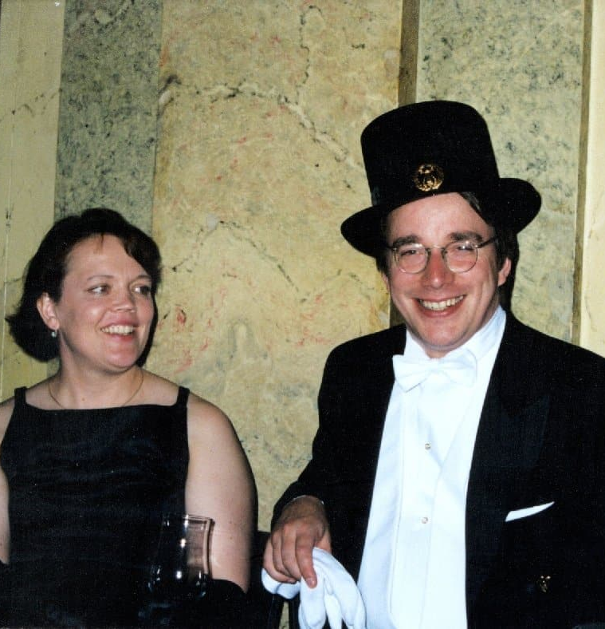
Personal life
Torvalds is married to Tove Torvalds, a six-time Finnish national karate champion, whom he met in late 1993.
They were later married and had three daughters.
As a fun fact: the Linux kernel's system call accepts their dates of birth (written in hexadecimal) as magic values.
(Magic values: A unique value with unexplained meaning or multiple occurrences which could (preferably) be replaced with a named constant)
After moving to US with his family, they've became US citizens.
Tove and Linus Torvalds. Unsure when it was taken though.

Slide 9
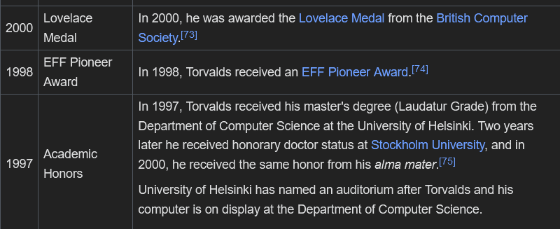
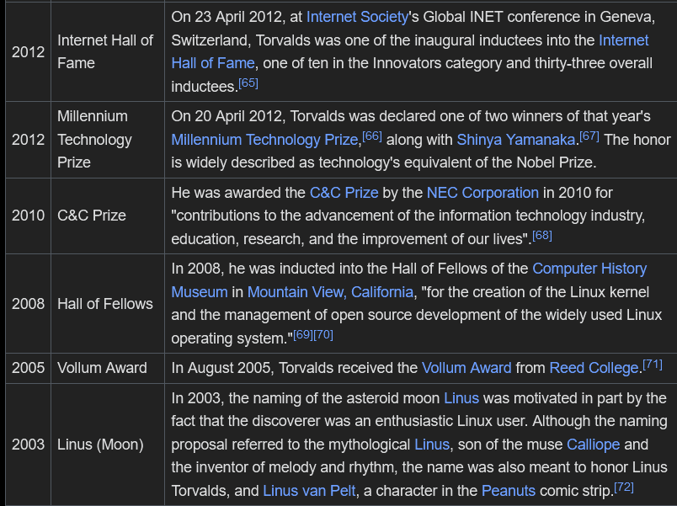
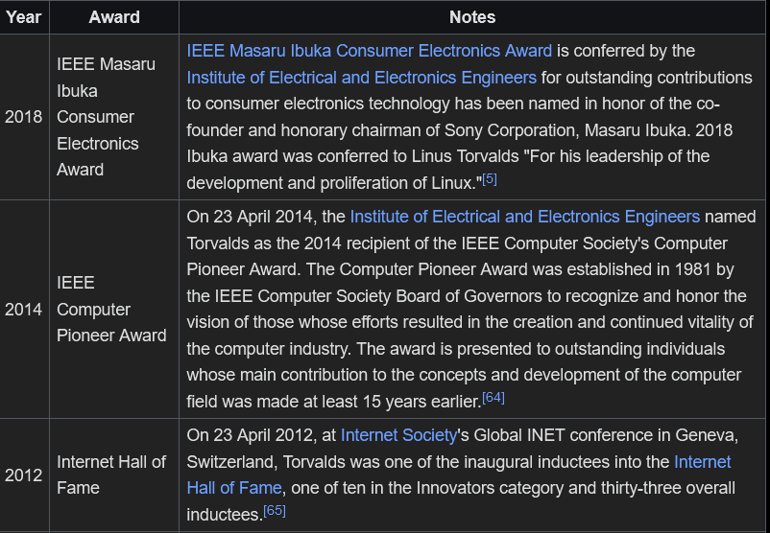
His awards and achievements
He has a moon and an asteroid named after him apparently. Didn't know this before, cool I guess.

Slide 10
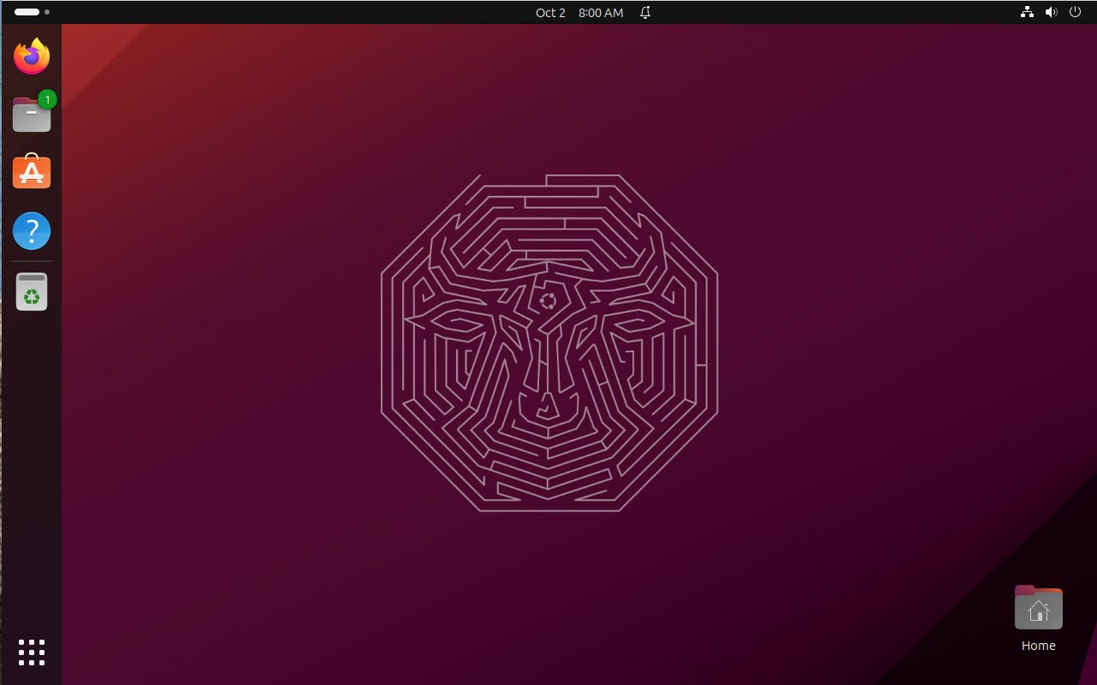
Linux's rapid growth
After Red Hat's adaptation to Linux, Linux has experienced a massive growth. By 2004, about 90% of web servers used Linux as their backend. This number has spiked to 99% nowadays.
Linux is also regularly used by about 3.3 billion users across the globe (Android users). Linux also holds a 6% market share in desktop computing (If we count chrome OS)
A popular linux distro, called Ubuntu

Slide 11
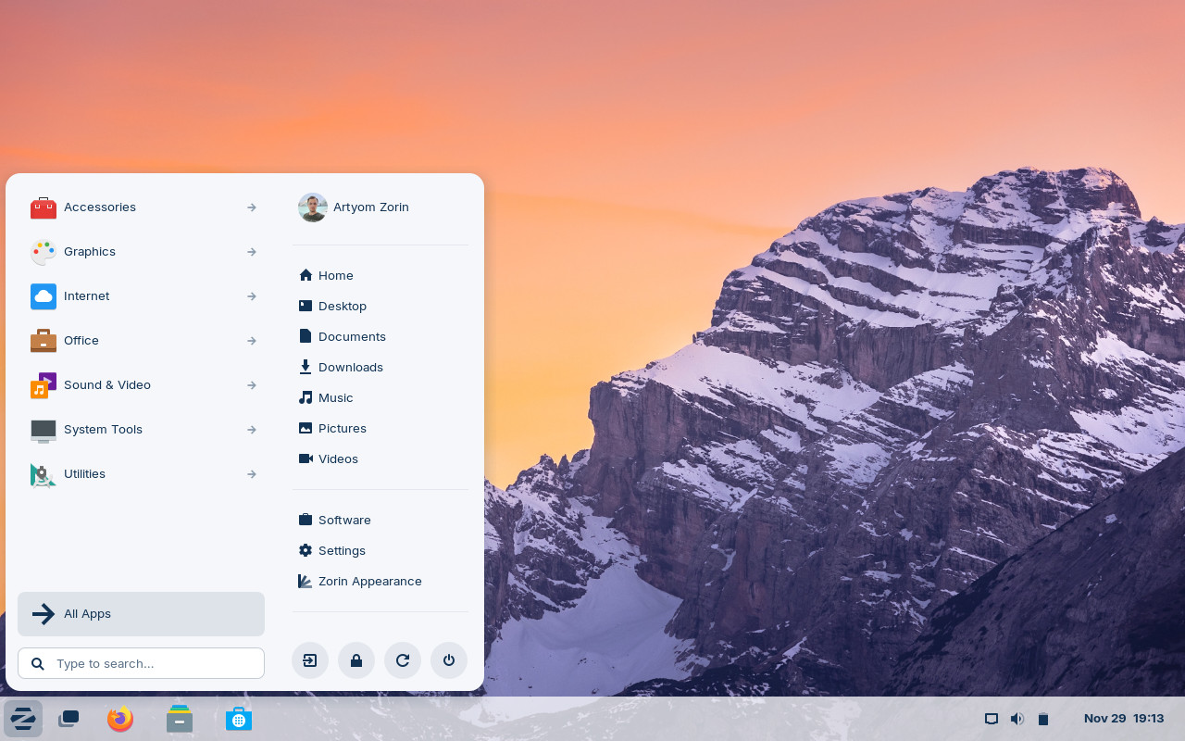
What made Linux great
Linux is fully open sourced and it's source code can be found in the internet.
While Torvalds might seem like the person who wrote the OS itself, this isn't the case at all. By 2006, approximately 2% of the Linux kernel was written by Torvalds himself. The other 98% was written by the community. And this is just 2006, this value is even lower nowadays.
Torvalds doesn't write the OS anymore, he said in 2012 that his own personal contribution is now mostly merging code written by others, with little programming.
Another Linux distro called Zorin OS.

Slide 12
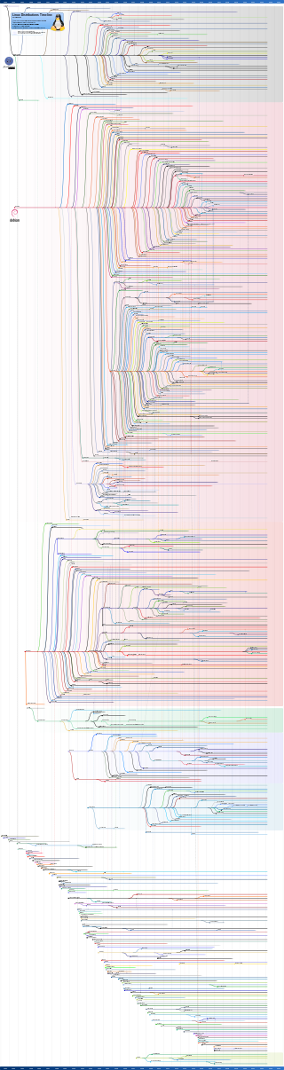
Why Linux?
Since Linux is fully open source (and thanks to its GPL v3 license), a lot of companies have customized it to their needs and removed the parts they didn't need. This is why your robot vacuum, printer, router and basically any smart device you own runs Linux underneath.
The community has also contributed and cloned the Linux project and created their own projects. These are called distros, and there are thousands of them.
Linux is also super fast compared to other operating systems like Windows.
Linux Distro Tree.

Slide 13
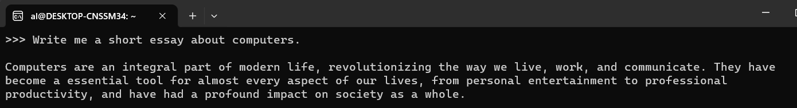
AI and Linux
An AI language model I ran on my system
Since AI is rapidly advancing nowadays, it's also worth to talk about AI and Linux. To get any AI system running locally on your system, you'll need Linux. The reason is that AI requires specific modifications to the OS kernel (Kernel is like the core of an operating system) and other operating systems are locked down, there isn't really an opportunity to do it without sacrificing performance and reliability.

Slide 14
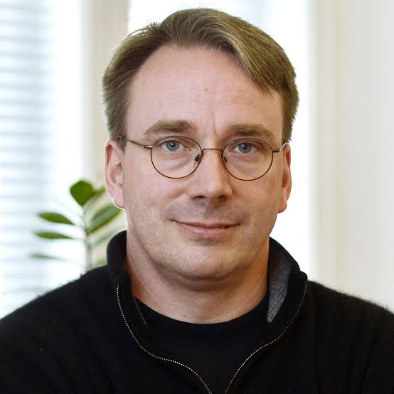
Closing thoughts
Linux is the perfect example of people working on something to make it great. It's also the biggest open source project in the entire world.
The reason why I went with Torvalds because generally he (and Linux) isn't really known by regular people. I thought it would be interesting to talk about him and his project here.
Sources:
https://en.wikipedia.org/wiki/Linus_Torvalds
https://en.wikipedia.org/wiki/Linux
https://en.wikipedia.org/wiki/List_of_Linux_distributions
Another random picture of Torvalds. Why do I even add these?

